Slide 1

相关与回归分析及其应用(1)
王志恒
Zhiheng.wang@pku.edu.cn
28.10.2019 @ PKU, China
Department of Ecology
College of Urban & Environmental Sciences
Peking University

Slide 2
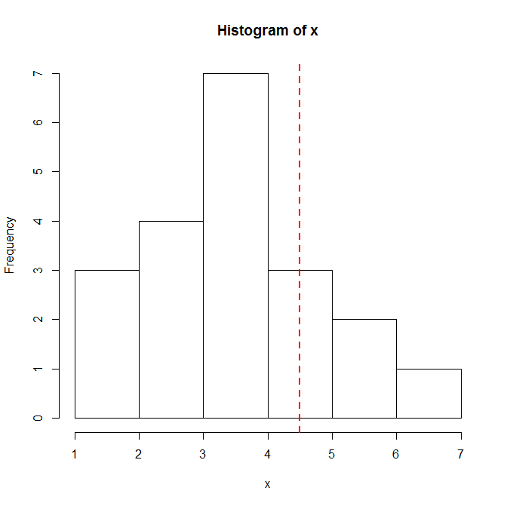
Using statistics: t-test
分析水中某元素含量与期望值是否具有显著差异
## concentration of a chemical in water, mean = 4.5
> x <- c(2.918, 2.730, 3.536, 3.879, 3.746, 1.921, 3.314, 2.593, 6.249,
1.747, 4.296, 1.315, 3.393, 5.381, 4.298, 5.329, 3.953, 4.309,
3.067, 2.749)
> hist(x)
> abline(v = 4.5, col="red", lty=2, lwd=2)
> ex.t.test <- t.test(x, mu = 4.5)
## a t test step-by-step
> se <- sd(x)/sqrt(length(x))
> t.stat <- abs(mean(x) - 4.5)/se
> (1 - pt(q = t.stat, df = 19))*2

Slide 3
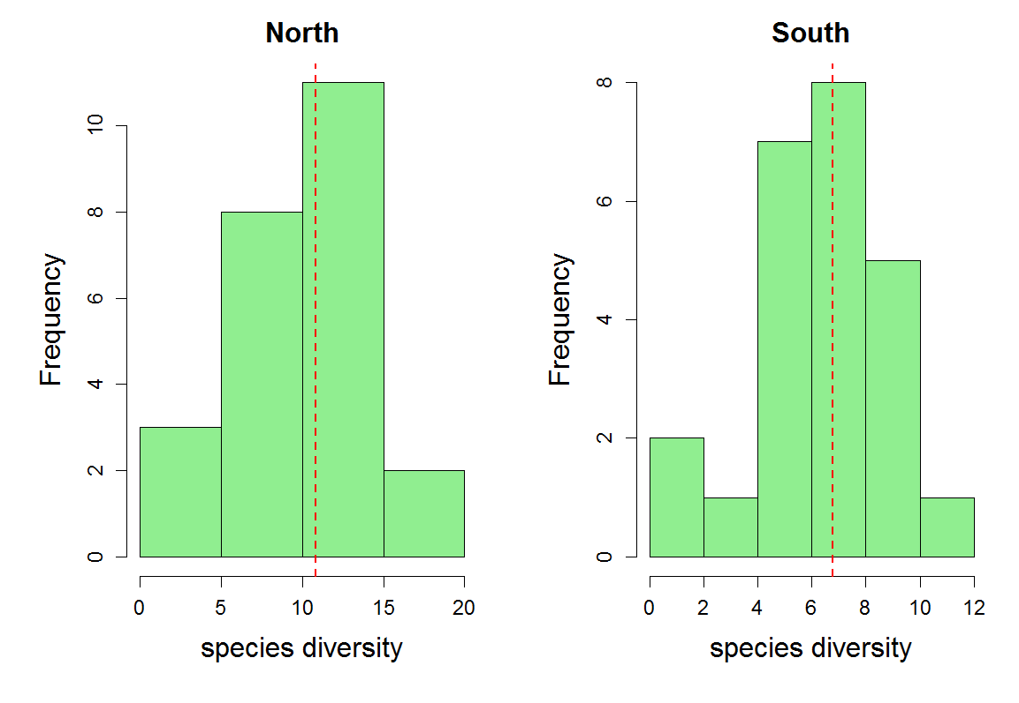
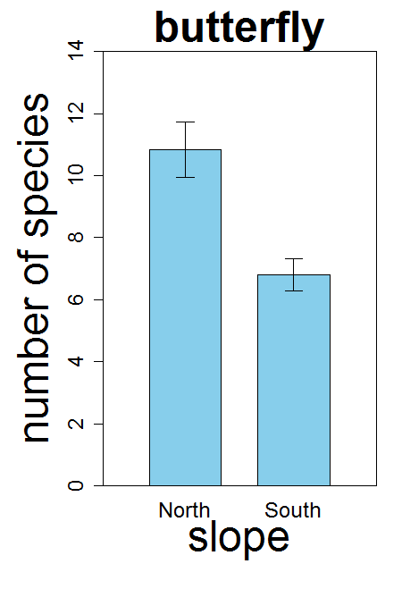
Using statistics: t-test
To compare if the mean species diversity on the two slopes are significantly different, you can use a t-test. Before the analysis, it is always a good idea to look at the histogram of you data, which can be done by “hist”

Slide 4
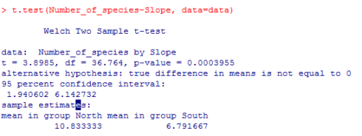
Using statistics: t-test
## t-test
t.test(Number_of_species~Slope )

Slide 5
Correlation between different variables
例子：比较不同生活型物种有齿物种比例与全部物种有齿物种比例的关系，确定主导全部物种叶缘变化的生活型
方法：Pearson相关
cor(x, y, method="pearson")

Slide 6
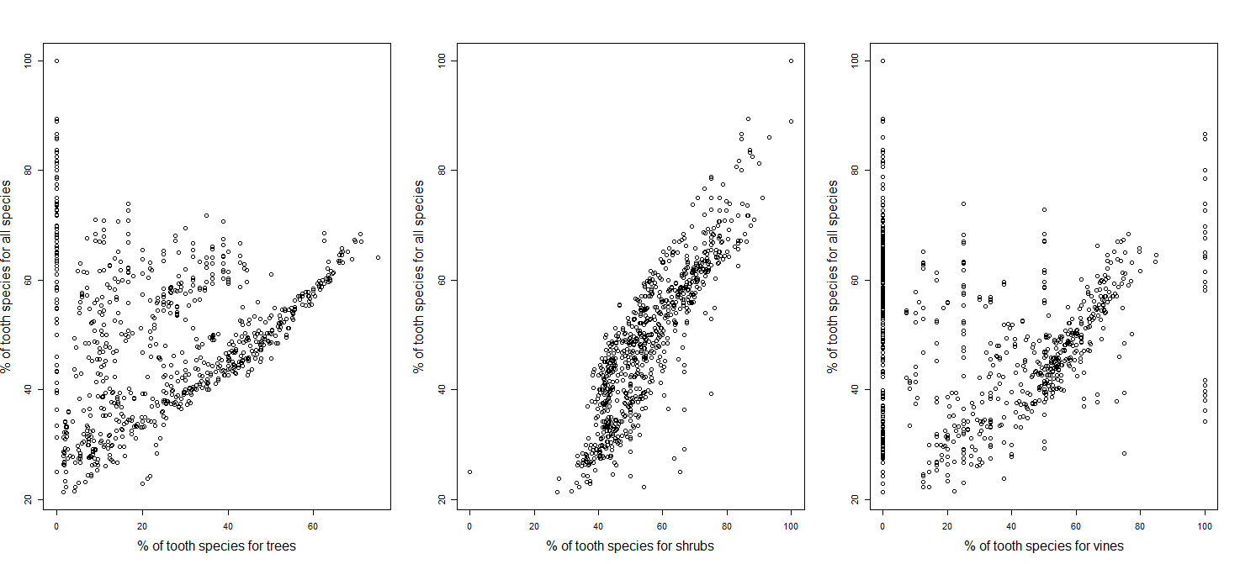
Correlation between different variables
It is always a good idea to explore the scatter plot before conduct correlation analysis
r = 0.0258
r = 0.8931
r = -0.1578
全部物种
乔木
灌木
木质藤本

Slide 7
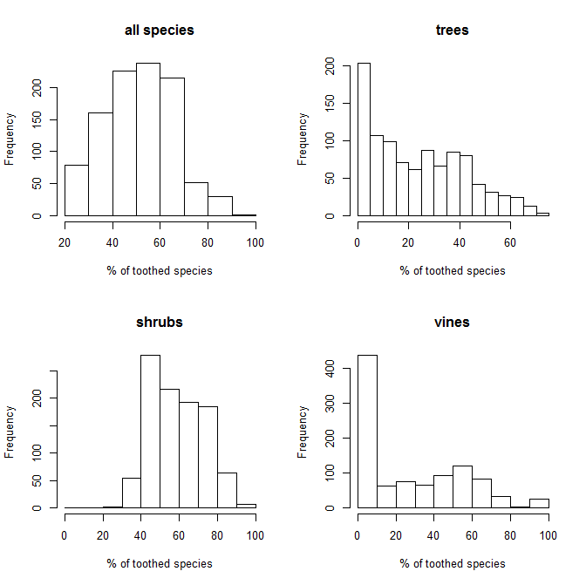
Correlation between different variables
多个变量呈现非正态分布
cor(x, y, method="spearman")

Slide 8
Correlation between different variables
例子：比较不同生活型物种有齿物种比例与全部物种有齿物种比例的关系，确定主导全部物种叶缘变化的生活型
方法：Spearman相关
r = 0.0258
r = 0.8931
r = -0.1578
r = -0.0209
r = 0.9032
r = -0.2480
全部物种
乔木
灌木
木质藤本

Slide 9
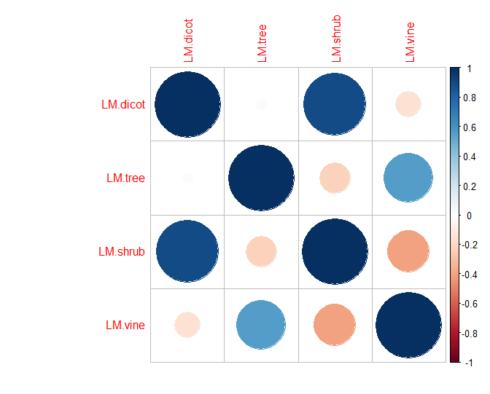
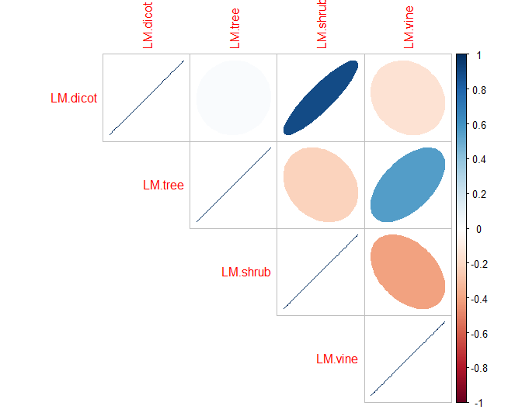
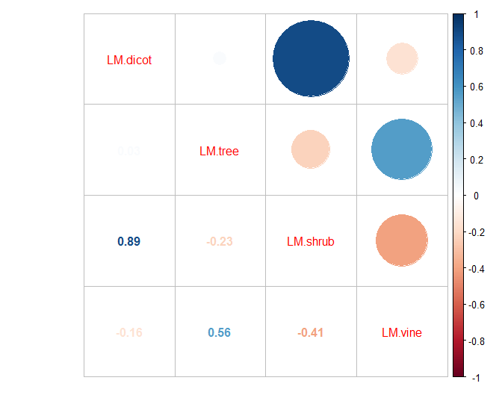
Examples to make figures: correlation plot
Show the correlations between the proportion of tooth-leaf specie.
corrplot(corr, method = "circle")

Slide 10
Simple linear regressions
Both correlation and regression analysis is a statistical process for estimating the relationships among variables. A correlation or regression is not necessary to a causal relationship.
In other words, it DOES NOT tell if one variable affects the other one.
It is always a good idea to explore the scatter plot before conduct correlation analysis

Slide 11
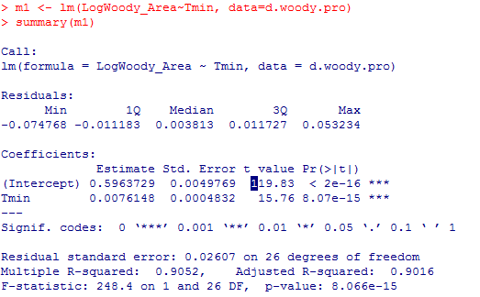
Simple linear regressions
分析木本植物物种多样性与冬季低温的关系：
## make a simple regression
m1 <- lm(LogWoody_Area~Tmin, data=d.woody.pro)
summary(m1)
R² = 0.91

Slide 12
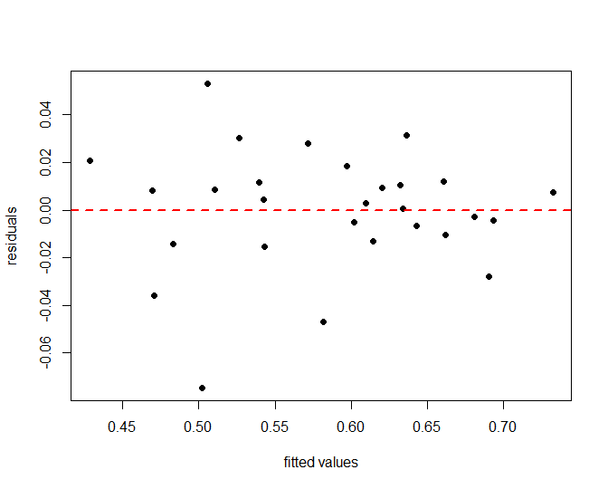
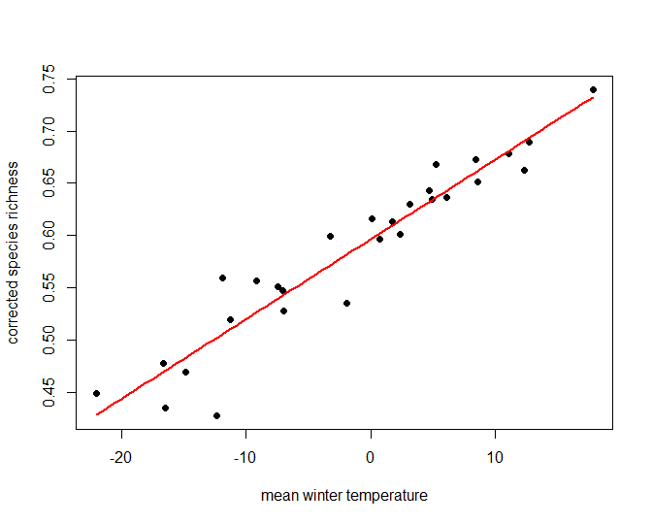
Simple linear regressions
## predict the outputs for given input
## values using a regression model
y.predicted <- predict(object = m1, newdata = newdata)
## extract the fitted values and
## residuals of a regression model
fitted.v <- fitted(m1)
resid1 <- residuals(m1)
plot(resid1 ~ fitted.v, pch=19, ylab="residuals", xlab="fitted values")
abline(h=0, lty=2, lwd=2, col="red")

Slide 13
Simple linear regressions
## predict the outputs for given input
## values using a regression model
y.predicted <- predict(object = m1, newdata = newdata)

Slide 14
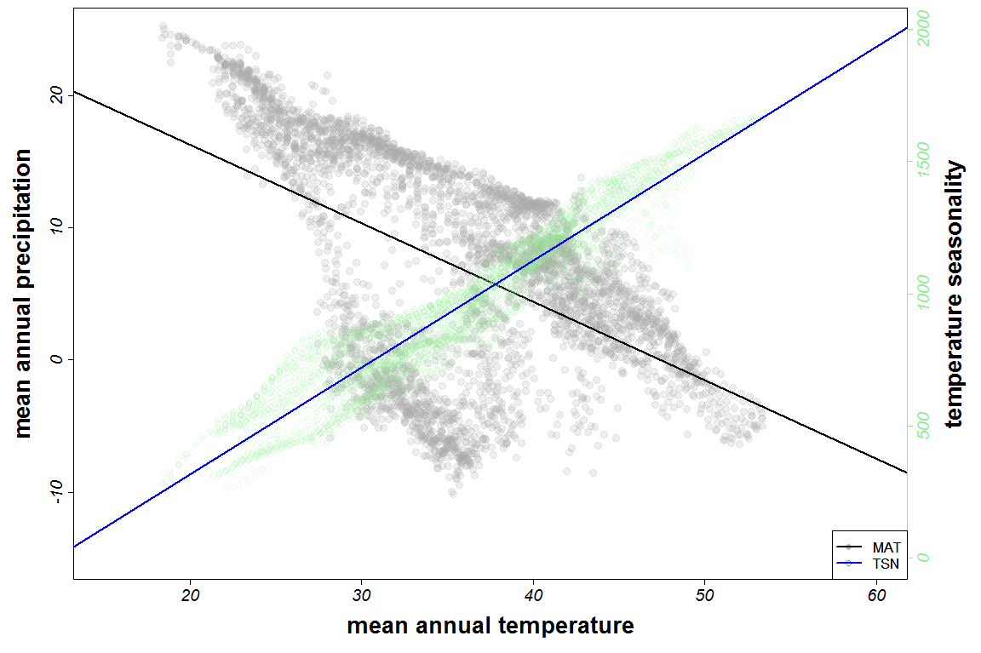
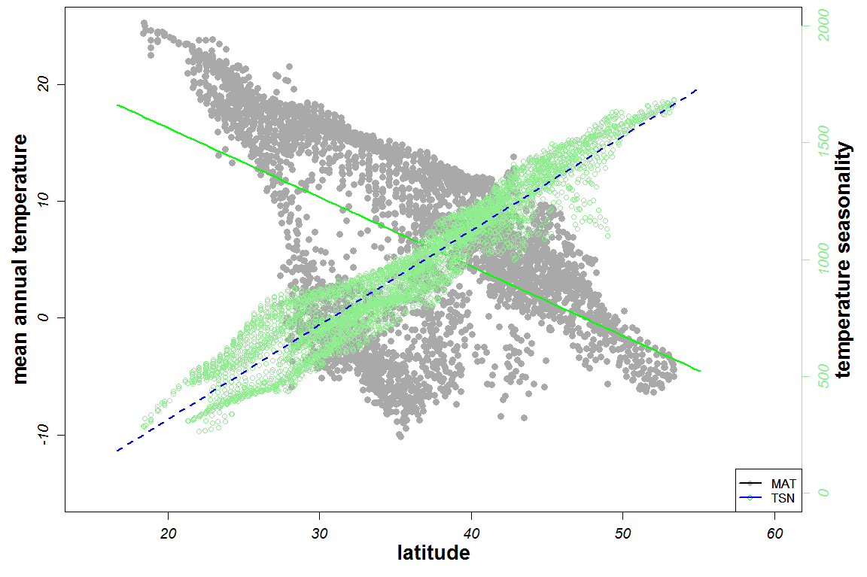
Simple linear regressions
## predict the outputs for given input
## values using a regression model
y.predicted <- predict(object = m1, newdata = newdata)

Slide 15
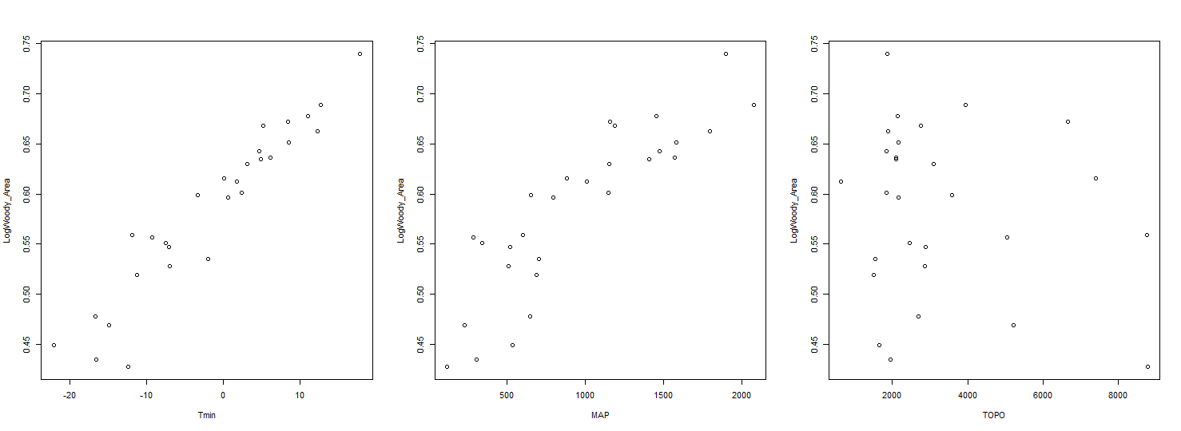
Multiple linear regressions
探索物种多样性与冬季低温、年降水和地形复杂程度的关系

Slide 16
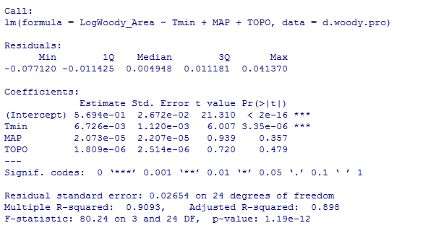
Multiple linear regressions
## make a multiple regression
> m3 <- lm(LogWoody_Area ~ Tmin + MAP + TOPO, data=d.woody.pro)
> s3 <- summary(m3)
> s3

Slide 17
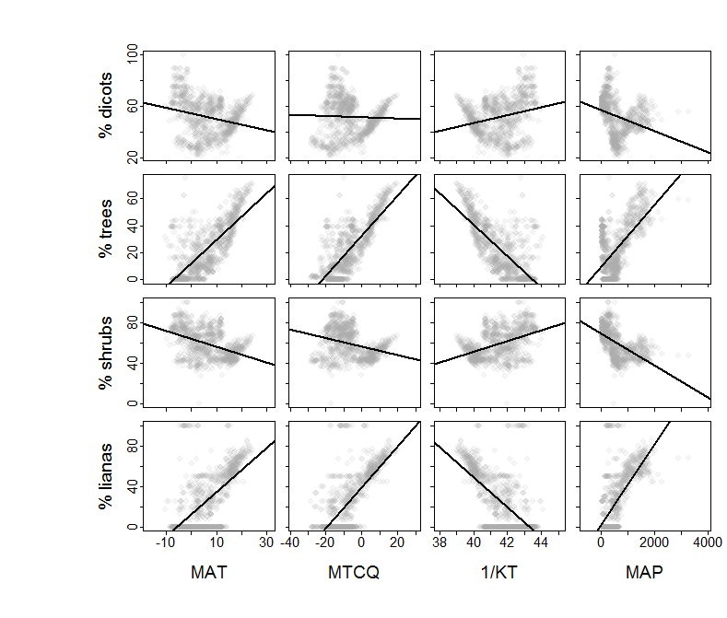
Multiple linear regressions
Show the relationships between the proportion of tooth-leaf species and climate variables.
Li Y et al. (2016) Global Ecology and Biogeography, 25, 1401-1415.

Slide 18
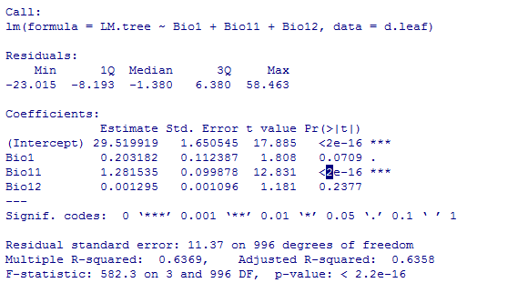
Multiple linear regressions
## make a multiple regression
m4 <- lm(LM.tree ~ Bio1 + Bio11 + Bio12, data=d.leaf)
s4 <- summary(m4)
s4

Slide 19
谢谢！

